Slide 1
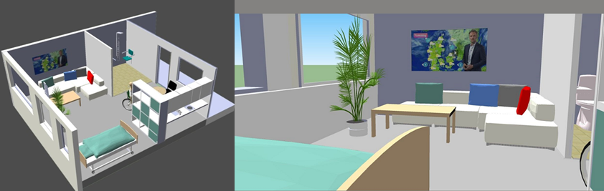
Computer engineering Project II - Introduction

Slide 2
Introduction
Motivation
Who are the instructors?
Who are the students?
What are your expectations?
Course contents
Description of qualifications (teaching goals)
Literature
Intelligent environments – a research summary
Projects and project report
Project management and work
Peer team and peer reviews
Teaching plan

Slide 3
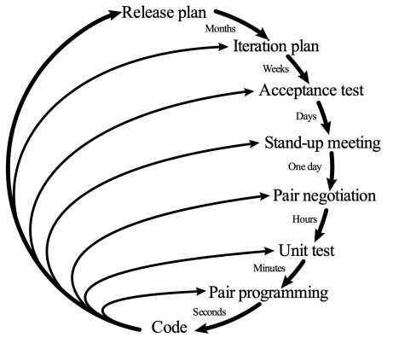



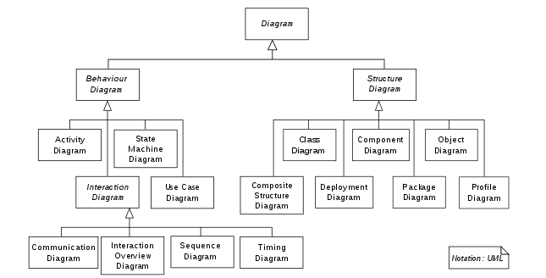
Motivation
You will be doing projects for the rest of your professional engineering careers
Projects are the very essence of engineering & you need to learn to work structured & speak the lingua franca of engineering
This will increase your productivity and reduce conflicts
And this is expected of you as a professional competence
Requirements specification
Architectural design
Detailed design
Coding and unit testing
Integration and testing
Operation and maintenance

Slide 4
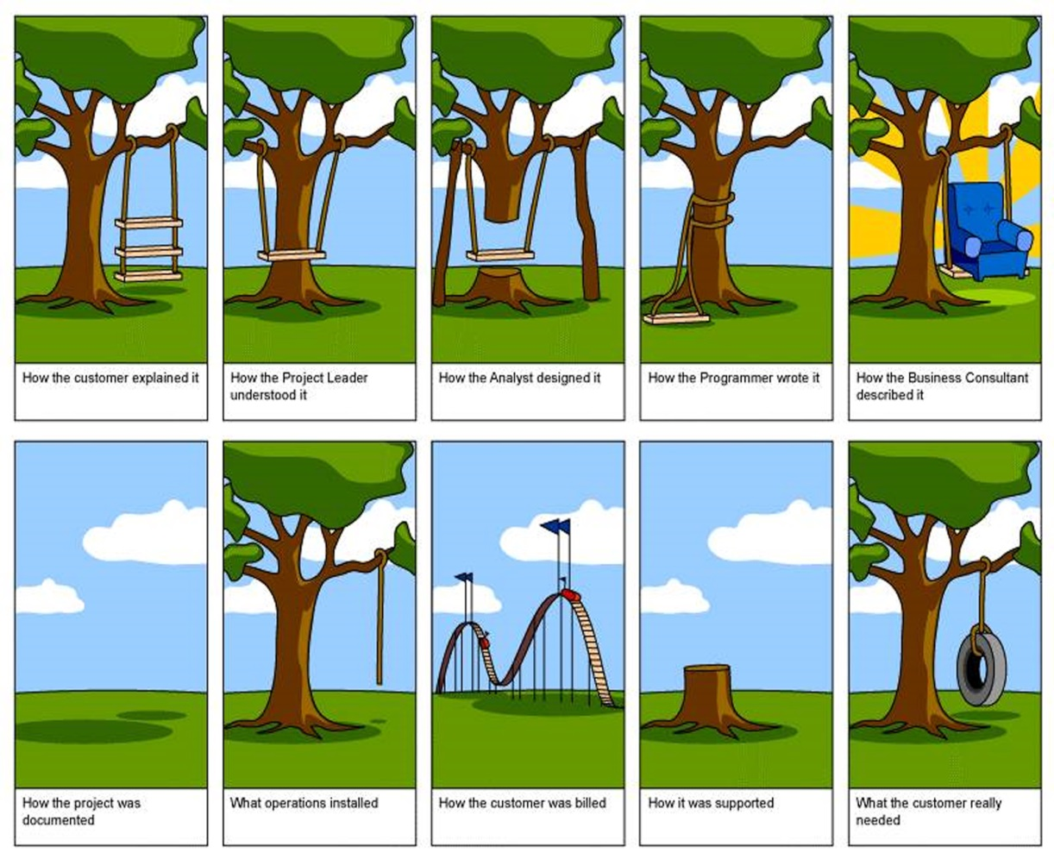
Real-life problems & solutions

Slide 5
Who are the instructors?
Main instructor and supervisor:
Associate professor Stefan Wagner
Availability: around 2 hours a week during course
sw@eng.au.dk
Assistant instructor (covers most tutorials):
Post doc Jorge Miranda
Availability: around 2 hours a week during course ONLINE only
jmiranda@eng.au.dk

Slide 6
Who are the students?
We would like to know more about you
Who are you?
What is your background?
What are your expectations?

Slide 7
Contents
The course provides an overview of, and practical experience with, some of the predominant theories, methods, and principles, for implementing computer engineering projects, both targeting industry and academia. Specifically, the course shall focus on the practical application of selected methods for analyzing, specifying, designing and developing distributed computing systems featuring multiple networked sensors and central storage and decision support platforms. The course interacts with the course on Software Engineering but with a focus on specifying, designing, implementing, and testing a complete distributed system during the course. This course allows the student to use the methods, tools, and technology platforms learned during the first, second and third semester to build a distributed system, consisting of a range of networked sensors. Each sensor will report data to a distributed server system, allowing for the remote monitoring of a variety of physical entities. Specifically, structured and agile development processes will be presented and used in the course, including Unified Process and SCRUM. Also, the students will learn how to use the Use Case method for specifying requirements for the development of a distributed system. Also, the students shall learn how to design and test the specified system, including doing peer reviews on the work of other student teams. (source: course description)

Slide 8
CONTENTS
What does this really mean?
You have learned a lot in Software engineering, Computer engineering project 1, Distributed systems, and other courses, now you put these qualifications to practical use
This will help you train your professional project work competencies
Which include: requirement specification, design, development, testing, and reporting
In short – you are going to make a great and fun project in groups of 4-5
You will write a 15-20 page report with appendixes:
Requirement specification (use case driven)
Design documentation (including detailed design with UML diagrams & source)
Test specification and documentation
For each participant: a detailed account of your personal work effort must be listed
NEXT “Description of Qualifications”

Slide 9
Description of qualifications
Description of qualifications = learning goals
There are quite many goals for a 5 ECTS course – but this must be seen in relation to the associated courses on “Software engineering” and “Computer engineering project 1”
You already learned the basics of programming, software engineering, and project work – now is the time to bring all your competencies into play in a real-world-like project
The list of qualifications is a kind of requirement specification for the course detailing:
What you have to learn in the course, and
At what level (level of understanding, ability to analyze, create, synthesize knowledge)
Defines what you need to master (and at what level) at the exam
Next we will look at the list of qualifications

Slide 10
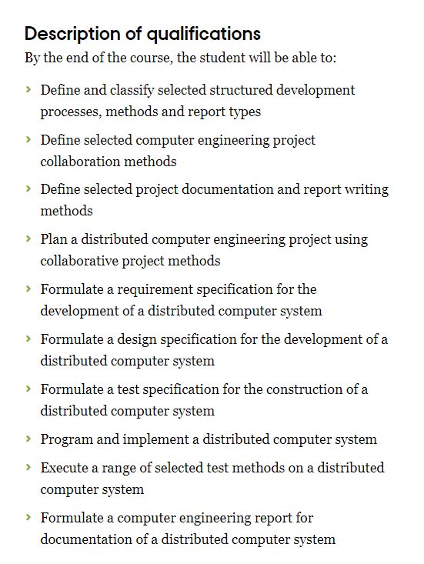
Methods: Learned in software engineering course (e.g. UP)
Practical: Choose relevant methods from book & produce reports
Methods: Learned in software engineering (e.g. SCRUM)
Practical: In the report – argue for different alternatives & choices
Methods: Introduced in software engineering
Practical: Showcase in your report that you know the literature
Methods: Introduced in software engineering
Practical : Make a plan – as a Gantt diagram & backlog
Methods: Learned in software engineering + CEP1 courses
Practical: Make a full requirement specification
Methods: Learned in software engineering + CEP1 courses
Practical: Make a full design specification (incl. UML + code )
Methods: Learned in software engineering + CEP1 courses
Practical: Make a full test specification (unit, integration, acceptance)
Methods: Learned in programming + distributed systems
Practical: Implement the system based on specifications
Methods: Learned in software engineering + CEP1 courses
Practical: Test the system based on your own test specifications
Methods: Get inspired by example documents
Practical: Write the 20 page report + appendixes

Slide 11
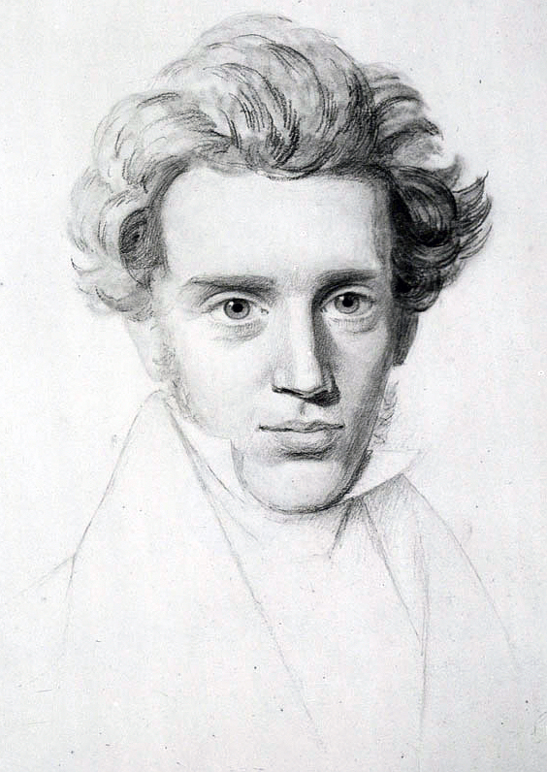
TRIAL AND ERROR
“Life can only be understood backwards, but it must be lived forwards” ~ Søren Kierkegaard
"Livet må forstås baglæns, men må leves forlæns.” ~ Søren Kierkegaard
Remember – learning to work in project teams cannot be taught – it must be experienced.
Trial and error through many, many projects, is the main way to learn the art of engineering.
Problem-based learning is the best didactic approach for gaining useful competencies
Software engineering best practices, methods, and techniques can guide us

Slide 12

Literature
You have already received all relevant theoretical knowledge in other courses – especially in Software engineering and Computer engineering project 1.
However, it has been decided that we will use the book “Software Engineering” by Ian Sommerville.
Both 9th and 10th edition are relevant.
At least 9th edition is available on the internet as PDF.
The instructors will not provide lessons on the content, but I will provide chapters to read for your understanding and reference (including for reference in your report) .
We will focus on Unified Process (UP), Use Cases, and Unified Modeling Language (UML).
You may adopt SCRUM or other Agile Methods.

Slide 13
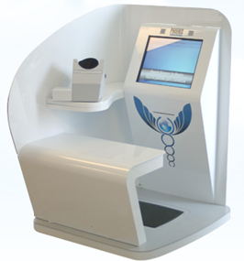
Intelligent environments
Smart Cities
Smart Homes
Smart Spaces
Factories
Pig pens
Offices
Desks
White boards
Operating theaters
Patient beds
Healthcare self-measurement stations

Slide 14
Projects
There will be two projects – both within the intelligent environment research field
1) Automated Light Guide – avoiding and registering night-time falls for the frail elderly
2) Kitchen Guard – creating a safer kitchen environment for the cognitively challenged
Half of the groups will be assigned to project 1 – the rest to project 2
For each group of “Automated Light Guide” there will be a peer review group of “Kitchen Guard” – acting as the “customer” – here as a “qualified customer” - meaning another engineering company having ordered the product from you. The group that provides peer review will receive peer review from another group.
For each week – a peer review statement and peer grade will be provided to the instructors by each peer review team. The grades are not part of the final grading.

Slide 15

Project 1: Automated Light Guide
Problem description:
Design, implement, and test a distributed system that can detect a user leaving his/her bed at night and which can turn on a guiding “ground-level” light which will automatically guide the user interactively towards the bathroom to avoid falling at night time.
Also, the user needs to be guided back toward the bed.
The solution should support at least five areas which jointly represents a “route” from the bed to the bathroom. Each of these areas should support automatically switching on the light of the current area occupied by the user – as well as the next area (the intended area)– and turning off the light in the previous area occupied by the user.
The system must be active from 22:00 to 09:00 and only when the last movement seen was the in the final area – that is the area closest to the bed. Also, the system automatically switches off after 09:00.
Next, the system must be able to report all events to a distributed “monitoring” server and database, including starting time, and time it took to reach the bathroom, the length of the bathroom stay, and the length of the return to the bed.
A distributed user interface server and client must be developed on a PC, tablet, web, and/or smartphone, for accessing the “monitoring” data. The server should be based on web technologies, either NodeJS, PHP, ASP.NET or Blazor (.NET)
The system could use movement sensors (PIR) to detect user presence and a power plug control unit connected to a LED light to turn on the light. Tutorials on Zigbee based sensors and actuators will be presented and supported – including Python code for the Raspberry Pi platform as the controller – but you are free to choose your own platform and programming language – just don’t expect support. For the server and database – we will provide examples in both Python and C#.
The system must support the MQTT protocol for server communication with JSON encoding – and it must support the HEUCOD recommendations.

Slide 16
Mini exercise 1
Discuss with your neighbor in groups of 2 or 3 :
What are the functional requirements of project 1 (use 10 minutes)?
What are the non-functional requirement of project 1 (use 5 minutes)?
What are you “free to define” as engineering team – and which are “defined by customer” (use 5 minutes)?
Sketch out which components are needed to create the product (use 5 minutes)
Which platforms and technologies from previous semesters could you use (use 5 minutes)

Slide 17
Project 2: Kitchen guard
Problem description:
Design, implement and test a distributed kitchen guard system that can detect a user leaving the stove unattended for more than 20 minutes and can automatically cut power if this happens – and provide reminders to the user that the stove was left turned on.
Also, the alerts are immediately cancelled when the user returns to the kitchen.
The solution should support identifying user presence in at least five five rooms – including the kitchen (e.g. living room, bedroom, bathroom) where localized reminders should be available – e.g. by flashing lights and optionally providing an audio reminder.
Next, the system must be able to report all events to a distributed “monitoring” server and database, including start and end time of all cooking (stove) operations, and the frequency and amount of time the user spent away from the stove.
A distributed user interface server and client must be developed on a PC, tablet, web, and/or smartphone, for accessing the “monitoring” data. The server should be based on web technologies, either NodeJS, PHP, ASP.NET or Blazor (.NET)
The system could use movement sensors (PIR) to detect user presence and a power plug control unit connected to a LED light to turn on the light for reminders and turn off the stove. Tutorials on Zigbee based sensors and actuators will be presented and supported – including Python code for the Raspberry Pi platform as the controller – but you are free to choose your own platform and programming language – just don’t expect support. For the server and database – we will provide examples in both Python and C#.
The system must support the MQTT protocol for server communication with JSON encoding – and it must support the HEUCOD recommendations.

Slide 18
Mini exercise 2
Discuss with your neighbor in groups of 2 or 3 :
What are the functional requirements of project 2 (use 10 minutes)?
What are the non-functional requirement of project 2 (use 5 minutes)?
What are you “free to define” as engineering team – and which are “defined by customer” (use 5 minutes)?
Sketch out which components are needed to create the product (use 5 minutes)
Which platforms and technologies from previous semesters could you use (use 5 minutes)

Slide 19
The project report
At the end of the semester – each group will hand in a project report
The report will be exactly 20 “normal pages” – that is 20 pages of 2,400 characters each
Also, five appendixes must be handed in with:
Requirement specification (use case based + non-functional requirements) – no page limit
Design specification (UML based) – no page limit
Implementation specification (or detailed design as part of the design documentation)
Test specification (and at least 1 approved instance of an accept test by peer review group)
An appendix detailing each participants active involvement in the project and report writing
The implementation can be handed in as bitbucket repo code with a sufficient amount of inline code documentation and precise instructions on how to run the code on the relevant platforms in relevant “install-readme.txt” and “run-readme.txt” files in the repo root
A video demonstration must be handed in from a real-world life scenario in the repo
And finally, a live demonstration & presentation, incl. a poster must be presented

Slide 20
PRESENTATION DAY
Is not the exam – but the day you showcase what you learned

Slide 21
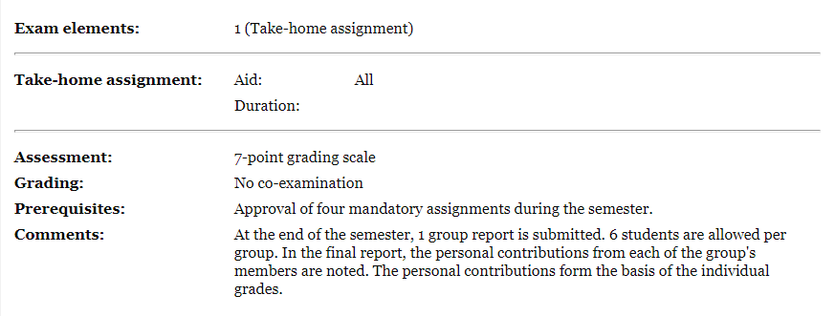
Exam
The most important element of all courses
The four mandatory assignments are the appendixes that must be approved by the instructors AND your peer review team are: M9, M10, M11, and M12

Slide 22
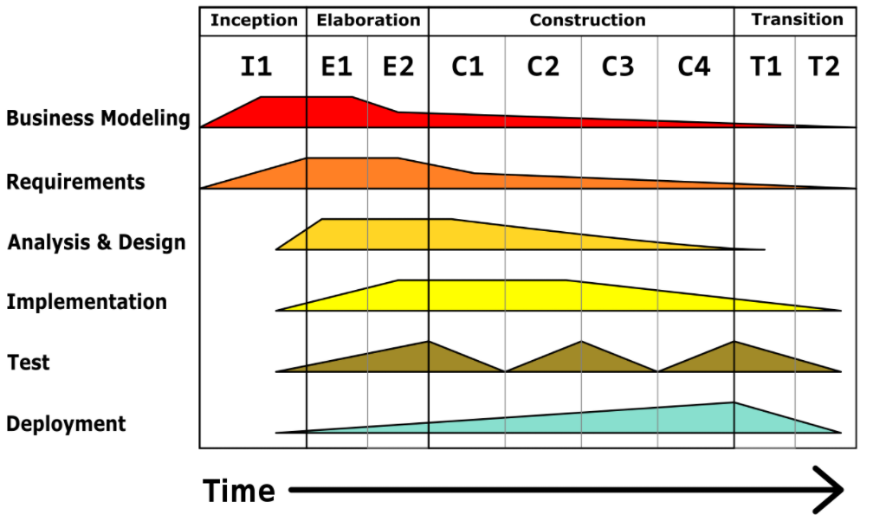
Unified Process – the PROECSS we use
HOW TO DOCUMENT
YOUR PROJECTS:
Project report
Requirement specification
Design specification
Implementation spec.
Test specification
Demo/video presentation
Project report
You may add Scrum or XP if you like – but there will be no support (from scrummage from rugby / Extreme Programming))

Slide 23
Week plan 1-4
Week | Agenda | Milestones | Reading | Tutorial
W1. Introduction | Course introduction | M1. Form groups and start requirement specification | SE (9th or 10th) Chapters 1-2 | T1: Setting up the Pi
W2. Requirement specification | Finalize requirement specification | M2. Finalize iteration 1 of requirement specification. | SE: Chapters 3-4 + 3 previous final year project reports | T2: Installing Mosquito server on Pi & PC
W3. Architectural design I | Create high-level design specification | M3. Finalize iteration 2 of requirement specification. Approved by peer team | SE. Chapters 5-6 | T3. Setting up Zigbee2Mqtt (Z2M)
W4. Architectural design II | Finalize architectural design | M4. Finalize version 1 of architectural design specification | SE. Chapters 7 | T4. Z2M and PIR sensors

Slide 24
Week plan 5-7
Week | Agenda | Milestones | Reading | Tutorial
W5. Detailed design I | Implement first prototype 1 – PIR only | M5. Finalize version 2 of architectural design specification. Approved by peer team | SE: Chapter 8 | T5: Z2M with power sensor & LED
W6. Detailed Design II | Implement first prototype 1 – PIR only | M6. Update requirement and design specification | SE: Chapter 9 | T6: Python client for model and control
W7. Detailed Design III | Create high-level design specification | M7. Finalize iteration 3 of requirement specification. Approved by peer review team | Krutchen 1995: Architectural Blueprints—The “4+1” View Model of Software Architecture | T7. Storing data in database

Slide 25
Week plan 8-10
Week | Agenda | Milestones | Reading | Tutorial
W8. Test specification I | Create test specification | M8. Finalize version 3 of architectural design specification. Approved by peer team |  | T8: Creating a web server with database
W9 Detailed Design IV | Implement prototype 2 – complete version | M9. Update requirement and design specification |  | T9: HEUCOD recommendation in Python
W10 Detailed Design V | Create high-level design specification | M10. Finalize iteration 3 of requirement specification. Approved by peer review team |  | T10: Adding Buzzer to Pi

Slide 26
Week plan 11-13
Week | Agenda | Milestones | Reading | Tutorial
W11. Test specification II | Create final test specification | M11. Finalize final test specification and final architectural design specification. Approved by peer team |  | T11. HEUCOD recommendation in C#
W12 Finalize prototype 3 and test | Finalize prototype 3 (final) and perform accept test | M12. Accept test specification approved by peer team – incl. one successful instance (none or few errors) of accept signed by at least two members of peer team. |  | T12. Advanced: TLS/SSL, + LINUX Daemons
W13 Presentation week | Demonstration of your projects | M13. Hand-in all documentation

Slide 27
Tutorials
Every week – Jorge will have a 20-30 minute video or live lecture and PDF tutorial ready for you
It will showcase some piece of technology that you will need for the project
How to setup the Pi, How to setup MQTT Broker, how to setup PIR sensors
Jorge will be available by Zoom 1 day a week (during the 2 hour time slip) – and each group has a 20 minute timeslot reserved during this day for Q&A
Also, on BB there is a Q&A board, where all can write and ask
One for technical stuff, and one for process stuff

Slide 28
Corona plan B (and C)
Plan A is that the course will start “in person” with first lecture (introduction) on February 2nd and forming groups on February 3rd
If Corona continues past these dates into February – the introduction week will be moved until we can meet “in person”.
It makes little sense to start the projects online – and I also want to meet you all in person if possible the first time at least.
Thus, if we are NOT cleared to meet February 2nd – which is the planned first day –the slides from this introduction will be made available as part of plan B detailed in the following.
We may end up with a plan C or even a plan D if the lockdown continues.

Slide 29
PLAN B, C, D
PLAN B
If university is closed until mid February – you will spend the first week reading previous project reports and the chapters 1-6 in the course book. There will be no lectures. Just reading. A bit of a bore
This is suboptimal – but means that you will have more time to work in the projects from mid February – as you will already have read most of the course literature and the total amount of project time will be the same in the end – just condensed a bit
PLAN C
If university is closed until early March – we will do the introduction mid February(9th or 10th) ONLINE – and I will simplify the project. In the last two weeks of February you will make requirement specifications and do individual tutorials – and we will try to get equipment for all of you – not just for your groups
PLAN D
If university is closed after March I will change the project to a pure online format

Slide 30
Forming GROUPS
It is paramount to create operational and effective groups
The formation of groups will happen in two phases:
1) Voluntarily create groups of 4-5 team members
2) Instructors will create or modify groups with remaining students
Send suggested groups to me (name + study number): sw@ece.au.dk
For each group select a project leader – the project leader will lead the meetings with the customer (peer team) and with the instructors. The project leader will at the beginning of each meeting appoint a new rapporteur (dansk: refererent), and all decisions will be documented as part of your documentation with “minutes of the meeting” (dansk:referat).

Slide 31
Questions?

